Slide 1

IOT AnalytiCs
AssignMent 4:
A SoCial DistanCing indiCator and alarMing along with Patient Monitoring using teMperature Sensor
Link for projeCt: https://www.tinkerCad.CoM/things/0pqwqGgJQvF
Submitted by :
21030242030 - Konkona Baruah 21030242036 - Ojaswi Pratulya 21030242060 - Tanvi Senjaliya 21030242064 - Vanshika Bhatia

Slide 2

AIM
To create a smart health monitoring system with multiple functionalities. The system includes multiple tasks, one at a time using the pushbuttons. It facilitates the following activities:
Measure temperature and pulse rate using different sensors. It can also be used as a social distancing reminder outdoors.
We also made a device that can be used as a medicine reminder using IR remote.

Slide 3
Literature Survey
One of the primary thing which goes down when disaster strikes is communication lines. Crucial patient data relayed through verbal communication channels often are misinterpreted, wrongly recorded or not recorded at all. This lead to hospitals or other resources not ready to recieve or treat patients. The paper proposes a system [4] which integrates 4 sensors like ECG, BP, Temperature and Pulse Oximeter sensors into one module. Another system [5] uses uses Arduino nano to collect data and see if the patients are recieving indoor mobility assistance or not. Similarly, in paper [2], a system uses NodeMCU as the processor to transmit data by sensors and dispay it on ThingSpeak. The data collected is sent over the internet to the cloud using a wifi module from where it can be stored, analysed and acted upon.
Study [1] presents an IoT system with algorithms that enable environmental and structural monitoring along with emergency management. using ML models which are trained using predefined datasets, the model suggests safe paths for a person to move onto. environmental an structural sensors, cameras, NFC technology is used to give input to the model on which social distancing recommendations and warnings are given. the deployment is using small microcontrollers which are energy and space efficient.

Slide 4
Literature Survey (Contd.)
People in contemporary culture ignore numerous daily
The healthcare segment has many fields which can deploy IoT for better patient monitoring and servicing. But the efficiency of IoT devices to
necessities as a result of their busy lives. Dementia affects the
elderly and those with chronic illnesses who must take their medications on time without skipping any. The creation of a low- cost medical sensing, communication, and analytics tool that tracks patients' physical status and medicine intake or the need for changed or updated medicines in real time through the internet is conceivable [6]. Another proposed system, the IoT- based pill reminder, and monitoring system could significantly enhance medication adherence for patients. The system's key component is the smart pillbox that has embedded sensors to detect when pills are being taken. The IR sensor technology used in the pillbox provides a non-intrusive and accurate way of detecting medication intake [7]. However, the authors note that the notification system could be improved by incorporating a voice-alert notification. Web-based monitoring is required for the Internet of Things (IoT) network to enable active and real-time appointments of patients, hospitals, carergivers, and doctors.
monitor patients spread out in large
geographical areas is questionable and unreliable.
highly
The
paper [3] demonstrates IoT sensors
like temperature, respiration, accelerometer, and heartbeat sensors which are connected to a Raspberry Pi Board, which in turn acts as a small intermediate clinic from where data is relayed to healthcare professionals
worldwide so that they can take further actions on the patient.

Slide 5
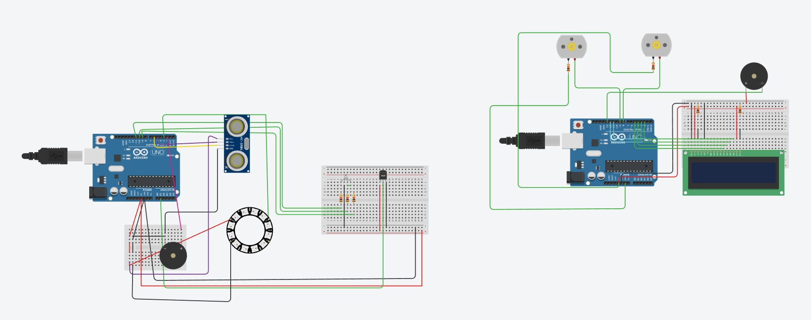
SMart HealthCare SysteM
Fig: CirCuit diagraM of SMart HealthCare SysteM

Slide 6
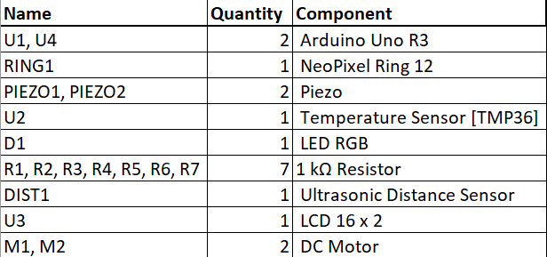
ResourCe RequireMent

Slide 7
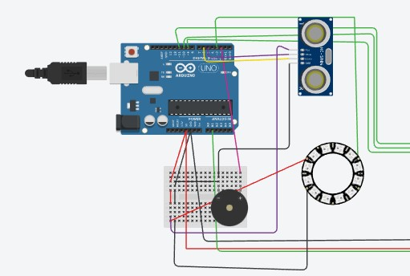
SoCial DistanCing AlarMing SysteM
For Social Distancing and Alarming System, Arduino UNO, Ultrasonic sensor, NeoPixel 12 RGB LEDs Ring, and Buzzer are connected to implement the system. Tinkercad text programming platform is used to implement it.
For the programming part we used text programming method. As soon as the araduino is powered up, the system starts measuring the distance in the range from 300 to 100 cm. The ultrasonic sensor echo pin is connected to digital pin 6 and trigger pin is connected to digital pin 5 of Arduino Uno board. As we move from safe to critical distance, at 100 cm all the LEDS will start glowing and the buzzer will give alert of violation of social distancing.

Slide 8

SoCial DistanCing AlarMing SysteM
The distance measured from ultrasonic sensor is mapped to number of LEDs glowing from 0 to 11th which are a set of
How does it works?
RGB LEDs.
The LEDs starts glowing with decrease in the distance of a person who is carrying the system and the other person who is not.
If distance reaches to 100 cm or less, the
buzzer activates and indicates social distancing violation along with all 12 RGD neopixel rings glowing.

Slide 9

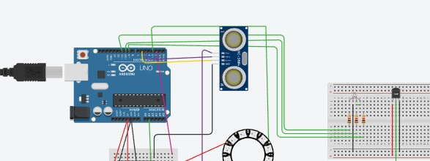
Patient Monitoring with TeMperature Sensor
For temperature sensing we have used, Arduino UNO, small breadboard, temperature sensor for input. For output we used RGB LED, 3 resistors to limit supply to the LED.
For the programming part we used text programming method. The values from the temperature sensor is connected to the analog pin A1 of Arduino. The unit we have choosen for detecting is degree celcius. . The temperature sensor comes in a variety of versions. The output voltage of this type, the TMP36, is conveniently proportional to temperature in degrees Celsius. r. As the temperature rises the LED will give different colors indicating if the patient is having a fever or not.

Slide 10
Patient Monitoring with TeMperature Sensor
We used controls to set different conditions. We choose three conditions in our case.
We used the RGB pins to show the output by
How does it works?
connecting them to pin no 11,10 and 9 of Arduino board.
Then we used conditions like :
If temperature < 36 deg C, no fever, and we set it in blue color
If temperature> 36 deg C, mild fever, and we set it to little greenish color
If temperature> 39 deg C, high fever, and we set it to red color

Slide 11
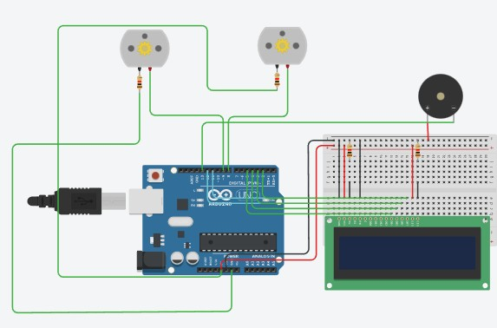
MediCine ReMinder
For Medicine Reminder system, we have used Arduino Uno, 2 DC Motors, resistors, piezo buzzer, LCD 16X2 and a breadboard.
For the programming part we used text programming method. We have connected the buzzer to pin 13 and LCD points to digital pin 12,11,5,4,3 and 2 of Arduino board.
Serial.begin(9600) code helps Arduino to send commands through USB connection.

Slide 12
MediCine ReMinder
We will start the stimulation with the serial.begin command
Digital pin 8 and 9 are the output pins of the LCD. And digital pin 7 is the input pin.
After starting the stimutation we have used
How does it works?
LCD.print command to display the name and quantity of medicines to be taken by patient 3 times a day.
We have used a delay of 1000 in between various medicne reminders because of time constraints.
The buzzer beeps as soon as the screen displays the name and quantity of medicines to alert the patient to take the pills without miss.

Slide 13
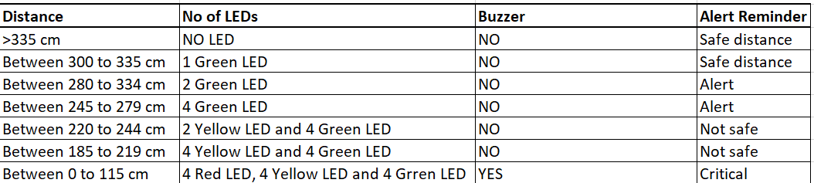
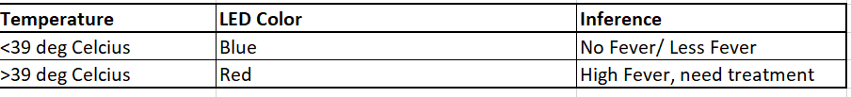
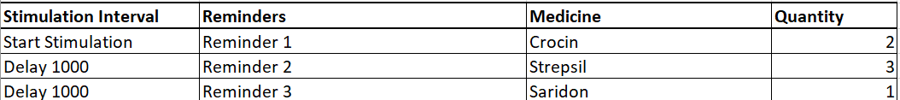
Observation and ConClusion
For Social Distancing Alarming system.
For Temperature Sensing System.
For Medicine Reminder System.

Slide 14

AppliCation of Proposed Methods
To detect people within close vicinity, a wristband with PIR sensors can be created. The suggested PIR sensor-fitted bracelet is simple to wear on the wrist. A buzzer, push button, speaker jack, Arduino (LilyPad), connecting cables, and two PIR sensors make up the bracelet. The person who is breaking the social distancing rule as well as the person who is wearing a wristband will be signalled by the buzzer.
In the automotive industry, temperature sensors can detect changes in engine temperature, alerting drivers of potential problems and prevent accidents. Automotive, retail, industry, water, energy, agriculture, consumer electronics, among others. All these areas can benefit from temperature sensors.
Medication reminder apps or medication adherence apps. They allow us to record the name of medicine, the dose to be taken and the time of day we need to take it.

Slide 15
Alternative ApproaChes
The conventional sensor-based diagnosis in the medical field requires a large number of sensors and human efforts, making it difficult due to a shortage of medical professionals and system setup.
To overcome this issue, an IoT-based health care application can be proposed consisting of a web and mobile application based on continuous wireless monitoring of patients' vital signs using sensors connected to a controller and transmitted to the cloud via Wi-Fi module.
The system will help implement a low-cost system and transmit the patient's vital signs in emergency situations, reducing the burden on doctors and providing the exact health status of patients.
One of the main benefits of this system is its ability to connect patients with specialists from all over the world. In case of emergency situations, the system sends a message to the doctor when sensor data exceeds threshold values, which minimizes the intervention time

Slide 16
IMpaCt Analysis
According to Gartner Research, IoT spend by healthcare providers will grow from
$16 billion in 2018 to nearly $52 billion in 2028 at a compound annual growth rate of 12%. Chronic condition management will have the largest revenue growth of $28 billion, but the highest growth rate will be in hospital hygiene monitoring (38% CAGR). Internet of Medical Things is one of the key applications of IoT for healthcare, impacting the industry in a positive way and has the potential to solve medical issues such as:
Simultaneous reporting and monitoring End-to-end connectivity and affordability Data analysis and data assortment Assisting the elderly
Real-time tracking and alerts Check-up on the go
Remote patient monitoring

Slide 17
Professional and EthiCal PraCtiCes
Huge amount of granular personal data being generated and sent over the open web to different servers
Adequate care should be taken to ensure data is not stolen in attacks or is not misused by the companies or healthcentres storing them
Since the data being shared has the potential of altering personal images and standing in society, it should be used in strict confidence, and non- disclosure clauses have to be made to prevent misuse
Also, data stored should not be outsourced to pharma and other companies for unnecessary marketing and sales gimmicks without patient consent. limited sensor data or stale data can produce results that can cause bias in diagnosis. Data integrity and quality have to be insured at all costs.

Slide 18


Thank you!

